Slide 1
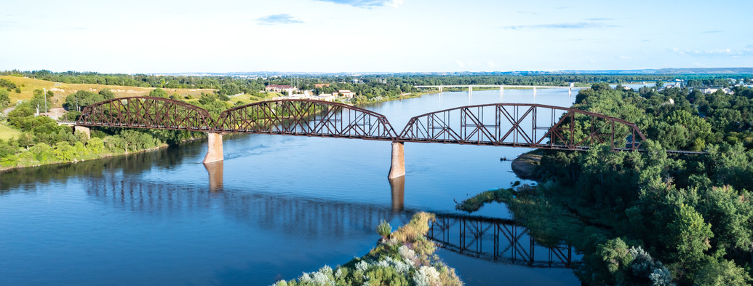
CS & Cybersecurity Integration plan

Slide 2
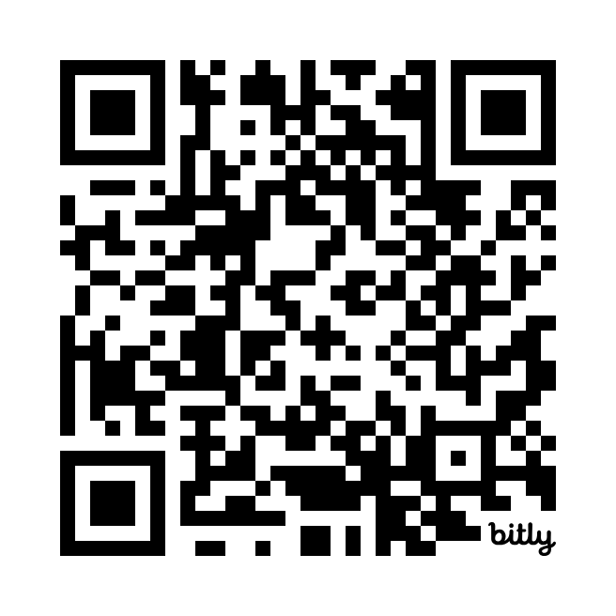
PRESENTATION COPY
Visit, https://bit.ly/ndsba-cs-imp
Links expire: April 24, 2024

Slide 3
Computers and Software are Changing Everything…
Computers and software are changing everything…

Slide 4
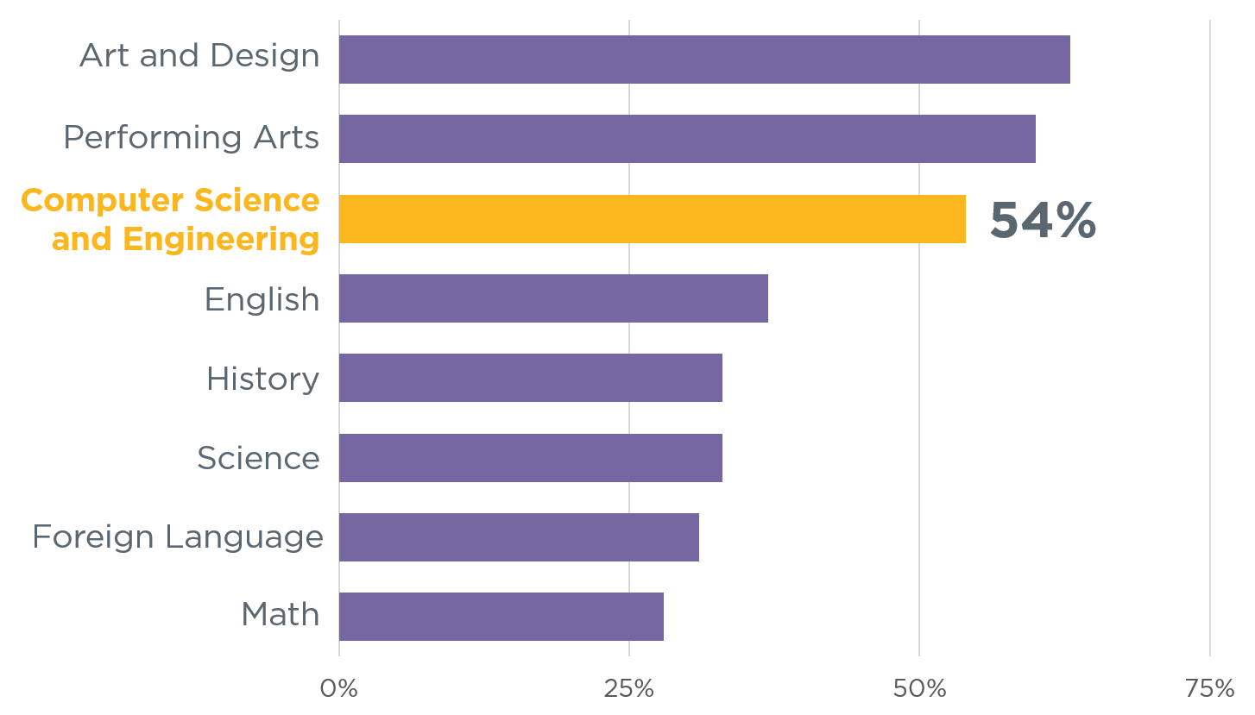
Even when students enjoy computer science and the arts the most
Even when students enjoy computer science and the arts the most
Source:
Change the Equation
Notes:
https://code.org/promote

Slide 5
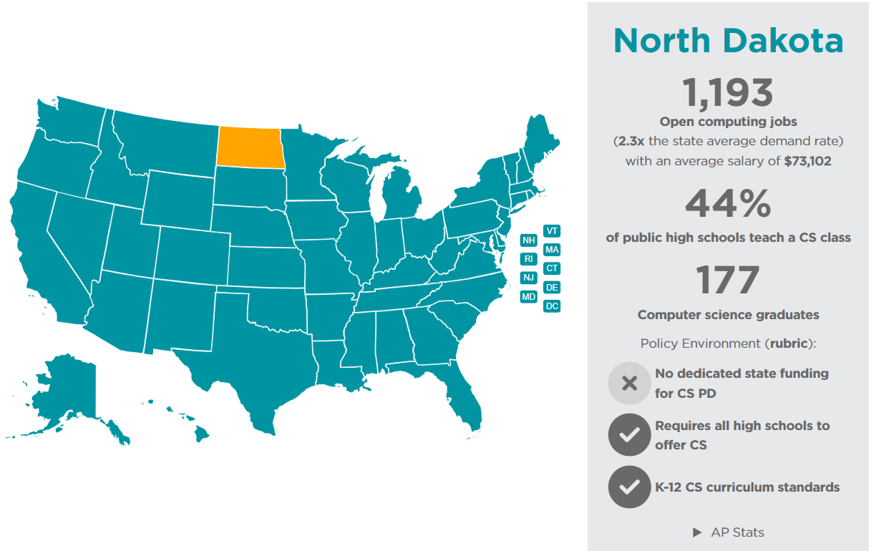
ND CS outlook July 2022
Screenshot from July 28, 2023
Notes:
https://code.org/promote

Slide 6
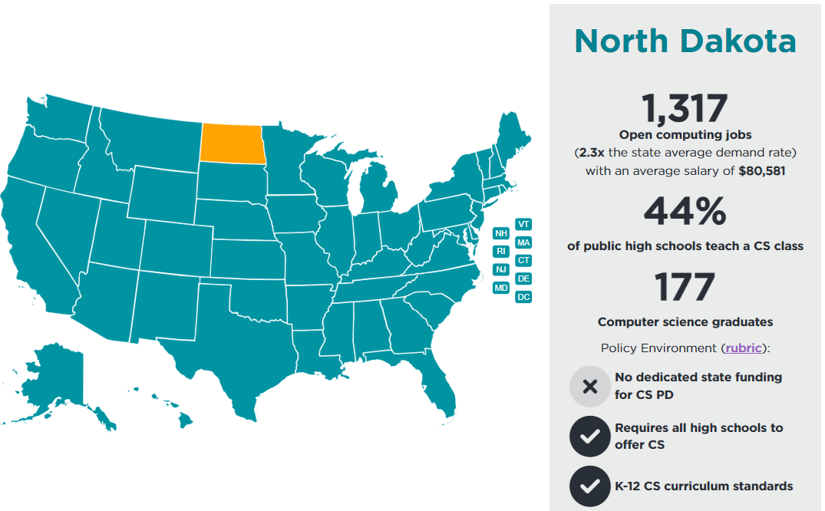
ND CS outlook October 2023
Screenshot from Oct. 26, 2023
Notes:
https://code.org/promote

Slide 7
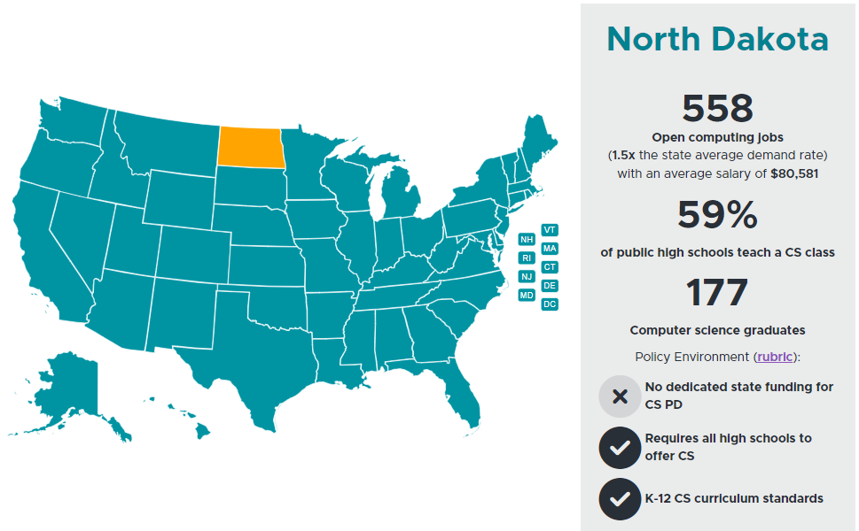
ND CS outlook March 2024
Screenshot from March 14, 2024
Notes:
https://code.org/promote

Slide 8
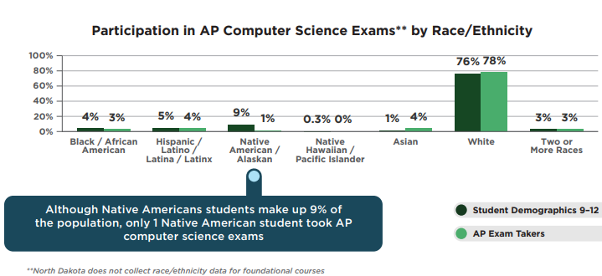
Demographics
76% White/Caucasian
9% Native America
4% Black/African American
5% Hispanic
1 % Asian
3% Two or more race
Notes:
https://advocacy.code.org/stateofcs

Slide 9
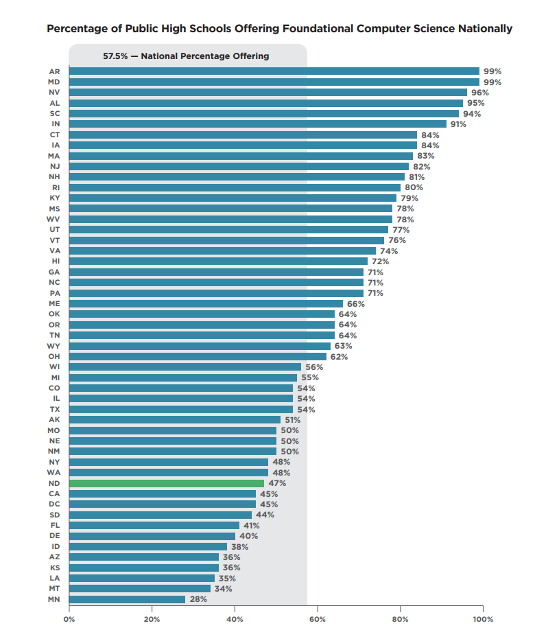
How Does ND Rank?
47% of High Schools offer CS
80% male students
20% female students
Notes:
https://advocacy.code.org/stateofcs

Slide 10
Provide Instruction
Provide Instruction
Existing Staff
NDIT-EduTech offers Professional Development (currently at little or no cost)
Bismarck State College program
🔥IgniteND conference
CTE endorsements
Regional Career and Technical Ed Centers
Center for Distance Education
Microsoft TEALS Program

Slide 11
Computer Science & Cybersecurity Timeline
2023-2024 School Year
2024-2025 School Year
High Schools provide instruction in CS/Cyber
Elem and Middle Schools provide instruction in CS/Cyber
Approved (not necessarily completed) Integration Plan

Slide 12
Computer Science & Cybersecurity Graduation Requirements
Through 31 Jul 2025
After 31 Jul 2025 (2025-2026 SY)
Specific CS/Cyber course counts toward math (previous legislation)
CS/Cyber courses satisfy the Science requirements
Students must take CS/Cyber course (one credit)
OR
Complete items in Integration Plan

Slide 13
Provide Instruction
Provide Instruction
Integration
CS/Cyber Course
CS/Cyber Course
Standalone (2300)
& Available
CTE CS/Cyber Course
Standalone (2700)
& Available
CTE Course (CS/Cyber Integrated)
K-5
6-8
9-12
Integration (Gen Ed Courses)
Integration

Slide 14
ND Computer Science- Cybersecurity Credentials
Credentials
Level 1
Level 2
Level 3
15 hours training
Integrating CS content
40+ hours training
6+ credits
Teach intro – intermediate level CS courses
200+ hours training
Teach ANY CS class
15+ credits
Notes:
https://www.nd.gov/dpi/computer-science-and-cybersecurity-credentials

Slide 15
NDIT EduTech PD options for credentialing
up to 16 hours each
Flexible Training Options
1 to 5-day workshops
Minecraft Education
CS Fundamentals
CS Discoveries
CS Principles (also offered as an AP course)
Intro to Python Using Micro:bit Micro:bit with STEM EDA
Cyber Society STEM EDA, and Science +
Computer Science in Minecraft
Cybersecurity With Micro:bits Intro to Micro:bit Using Block Coding
Computational Thinking Cybersecurity Basics

Slide 16

Register Today
Code.org | CS Discoveries or CS Principles
5- day summer workshop
NO COST
July 25 – August 8, 2024
REGISTER HERE
Day 1 & 5 – virtual
Days 2 – 4 @ Jamestown Middle School
Notes:
Professional Learning Program Details | Code.org

Slide 17
CTE Endorsements

Slide 18
CTE Endorsements
Added based on specific course trainings
  à la carte
  Aligned with specific course codes
  Courses fall under CTE 27xxx
Currently working on validating the courses offered that would qualify under HB1398
Application available at CTE.ND.GOV
  Cost to ESPB

Slide 19

WHAT is CSforALL?
Notes:
TYLER

Slide 20
CSforALL mIssion Statement
CSforALL’s mission is to make high-quality computer science an integral part of the educational experience of all K-12 students and teachers, and to support student pathways to college and career success.

Slide 21
SCRIPT Implementation Tool
Teacher
Capacity &
Development
Materials and Curriculum Selection & Content Refinement
Strategic
CSforALL
Resource &
Implementation Planning
Tool
Community
Leadership
Technology
Infrastructure
Partners

Slide 22
Why the SCRIPT?
No one-size-fits all model works for every education system
Create a framework to connect with CSforALL members and resources for the problems you are trying to solve
Allow education systems to set priorities and select characteristics for partners that fit their needs
Integrate into existing infrastructure and processes

Slide 23





LEA TEams
LEA Teams Overview
LEA Teams should consist of at least the following members:
REQUIRED LEA TEAM COMPOSITION:
An LEA administrator/
tribal department of education
A school leader
Another school-based member that can either be instructional or non-instructional (librarian, school counselor, etc.)
An educator that will teach or currently teaches CS

Slide 24
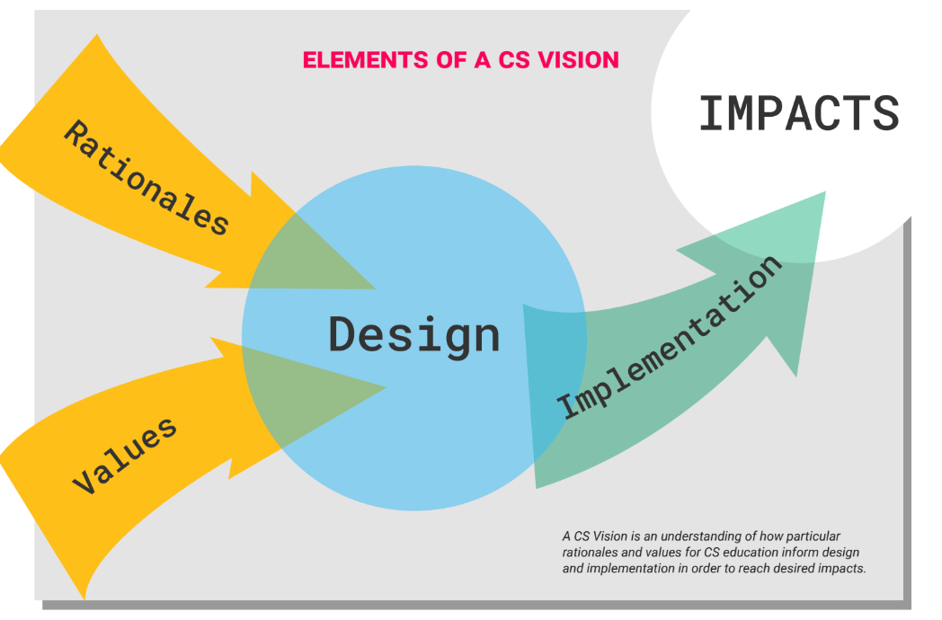
What is a CS Vision?

Slide 25







CS Visions Impact Areas
Personal Agency, Joy & Fulfillment
Economic & Workforce Development
Competencies & Literacies
School Reform & Improvement
Equity & Social Justice
Technological, Social & Scientific Innovation
Citizenship & Civic Engagement

Slide 26
Smartie Goal
S.M.A.R.T.I.E Goal

Slide 27
What is A Smartie Goal
Specific: Clearly defined
Measurable: You will have evidence that it is complete
Achievable: Challenging but defined well within available resources/knowledge
Result-focused: Measure outcomes, not activities
Time-bound: Linked to time frame
Inclusive: Brings traditionally excluded individuals and/or groups into processes, activities, and decision/policy making in a way that shares power.
Equitable: Includes an element of fairness or justice that seeks to address systemic injustice, inequity, or oppression.

Slide 28
What do SMARTIE Goals look like?
Ex 1: Within the next 3 months, survey current teacher workforce to identify any CS instruction or curricula currently being used in classrooms, and analyze gaps in access to CS instruction across the LEA including a breakdown of data by gender, socioeconomic status, and ethnicity.
S- survey teachers & analyze survey results
M- goal achieved if both survey administered & gap analysis completed within 3 months
A- up to LEA team to assess given available resources
R- result = identification of gaps in access
T- within 3 months
I- including teacher voice in landscape survey
E- aims to identify gaps in access to CS Ed
SCRIPT

Slide 29
Rubric Question
Rubric Question

Slide 30
Question 1 – Curriculum Selection
(Novice): No curriculum selected for any grade levels. No CS pathway options are evident.
(Emerging): Some CS taught in schools, curriculum selected by individual teachers with
no communication for pathway options. Some discussions occur among individuals
regarding CS efforts or curriculum selection. There is potential for CS pathway options.
(Developing): Some CS curriculum has been selected across multiple grade levels,
addressing relevant state and national standards and the K-12 CS Framework.
(Highly Developed): Selected curriculum are sequential, and student learning builds
each year in alignment with national standards and other district initiatives. There is a
process for both discussions across multiple grade teams to meet and discuss or refine the
curriculum and CS needs.

Slide 31
Question 2 –Ancillary Materials
(Novice): No support provided for identification, purchase, or development of ancillary
CS materials.
(Emerging): Few individual teachers may independently identify ancillary CS materials
for their own classes.
(Developing): Some ancillary materials connected to relevant CS curricula are identified
and shared between teachers. Ancillary materials may be shared across grade levels and
curricular activities.
(Highly Developed): All ancillary materials are connected to relevant CS curricula.
Working groups review and revise relevant ancillary materials for rigor and quality. District
communications include links to available, approved materials.

Slide 32
Question 3 – Lesson Development
(Novice): No support for teachers to create or modify CS lessons outside of regular
planning time.
(Emerging): Teachers are provided individual incentives (PD hours, et.) for lesson
development.
(Developing): Structures and/or incentives exist for working groups of teachers to
create or modify CS lessons in collaborative environments.
(Highly Developed): Lesson development is a part of teacher development and data
and student artifacts are used to support creation of new lessons or modification of
existing lessons.

Slide 33
Goal Setting
In your team’s doc, draft 3-month, 6-month and long-term goals and identify the rubric sub-component(s) targeted.
Goal Setting for Rubric 1
Materials and Curriculum Selection & Content Refinement
3-Month Goals | List your 3-Month Goal(s) here: Identify the rubric sub-component(s) targeted:
6-Month Goals | List your 6-Month Goal(s) here: Identify the rubric sub-component(s) targeted:
Long-term Goals | List your Long-term goal(s) here: Identify the rubric sub-component(s) targeted:

Slide 34
Get Started
Get Started

Slide 35
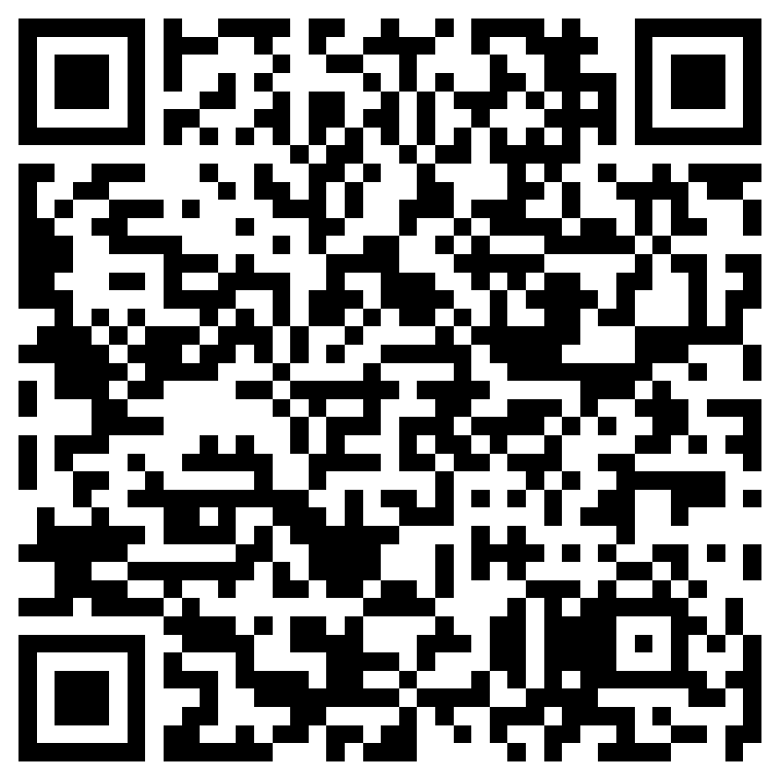
Interest Survey
The SCRIPT — the Strategic CSforALL Resource & Implementation Planning Tool — is a framework to guide teams of district administrators, school leaders, and educators through a series of collaborative visioning, self-assessment and goal-setting exercises to create or expand upon a computer science education implementation plan for their students.
Interested in bring the SCRIPT program to your school, scan the QR code

Slide 36

Code.ORG – District Partner
District leaders around the United States can now partner with Code.org directly, at no cost to:
Prepare students to thrive in a rapidly evolving world of work
Boost access to engaging STEM courses and pathways
Invest in teachers and administrators through high-quality professional learning experiences
Tap into the energy, aspirations, and potential of all students to close equity gaps in computer science education and career pathways
Align with the education-to-workforce priorities of employers and policymakers
If you become a district partner, Code.org has offered to cover the cost of SCRIPT training for educators to equip them to integrate the Code.org curriculum into their classrooms.
Notes:
https://code.org/districts
https://docs.google.com/forms/d/e/1FAIpQLSfFV_iJoDK4erZxIeX_tZiq5vZ7ZDa9HFjHbYzBDNLT9rIFhQ/viewform

Slide 37
Check out these Resources
HB 1398 Starter Guide
ND DPI | CS & Cybersecurity Credential/Resource
ND DPI | Integration Plan
CSforALL website
Curriculum Directory
EduTech website

Slide 38
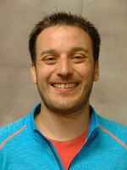

Questions
Tyler Ward | IT Specialist
tyler.ward@k12.nd.us

Slide 39
Questions for ND DPI
Contact Steve Snow | fsnow@nd.gov
Questions about implementation plan
Deadlines to submit plan to ND DPI
Additional Resources

Slide 40

Enjoy Your Next Session

